Slide 1


How Reliable is Your Wind Farm?
ESG Data Science Day 2022
Insurance Proposal for European Wind Farms

Slide 2
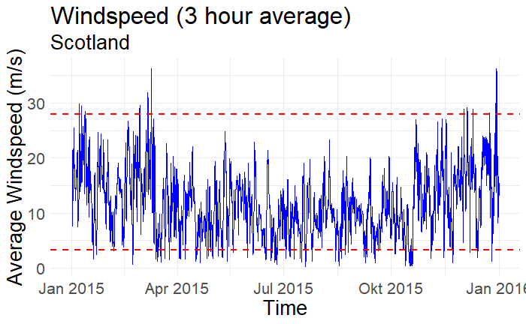
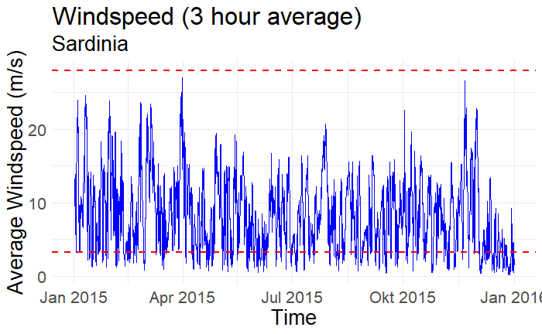
How are European Wind Farms Performing?
Onshore Wind Farms
Offshore Wind Farms
Cut-out loss less frequent than cut-in loss
General low volatility
Frequent cut-in losses
Higher volatility
Insights from Simulated European Wind Data (New European Wind Atlas (NEWA) during 2015)

Slide 3
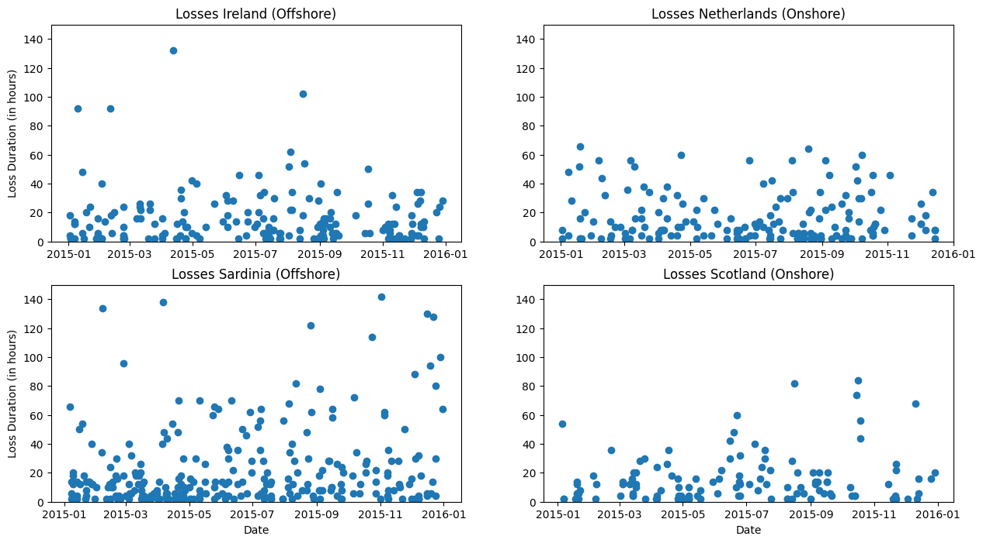
In Focus: Appearance of Losses
Many Short- and Long-term Losses (Offshore) versus Fewer Short-term Losses (Onshore)

Slide 4
Talking Numbers
Offshore (Sardinia)
275
Number of loss-periods
25.21 h
Avg. length of loss-periods
36h
80th percentile
Onshore (Scotland)
124
Number of loss-periods
15.56 h
Avg. length of loss-periods
22h
80th percentile
Measured Impact of Loss Periods per Shore Type

Slide 5
MunichRE Windsure
Policy Duration: One year (ensuring flexibility for climate changes)
Loss calculation = Duration of the loss event * price for kWh * max power of the wind farm (in kW)
Costs to customer: Expected Loss + further costs for the insurance product
Final premium for the wind farm owner depends on several factors like the size of the portfolio of the insurer
Loss event duration | P(Onshore) | P(Offshore)
>80 percentile | 0.068 (22 Hr) | 0.145 (36 Hr)
>90 percentile | 0.030 (36 Hr) | 0.046 (64 Hr)
Our Proposed Solution for your Wind Farm

Slide 6
Thank You For Your Attention!
ESG Data Science Day 2022
Feel Free to Ask Questions! (Group 6)

